Slide 1

Digital Communication UEC607
By Dr. Poonam Verma

Slide 2
Unit- 3rd
Detection and Estimation
Gram-Schmidt Orthogonalization procedure.
Maximum a Posterior (MAP) criterion.
Maximum likelihood (ML) decision rule.
Correlator Receiver.
Matched filter receiver.
ML estimation procedure.
Probability of bit-error & symbol-error calculations for digital modulation techniques under AWGN channel
Union bound on probability of error

Slide 3
Signal Space Representation
Signal space or vector representation is a very effective and useful tool for
Graphical visualization and expression of signal
To understand the concept of digital transmission
To analyze and evaluate the performance of digital communication

Slide 4
Type of Signal
Baseband signals are the message signal generated at the source
Bandpass signals refer to the signals after modulating with a carrier. The bandwidth of these signals are usually small compared to the carrier frequency.
Bandpass signals can be represented in three formats
Magnitude and Phase representation
Quadrature representation
Signal or vector space representation

Slide 5


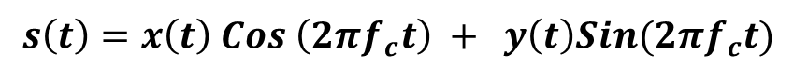
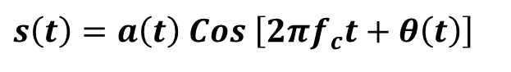

Magnitude and Phase Representation
$s\left(t\right)=a\left(t\right) Cos \left[2πf_{c}t+θ\left(t\right)\right]$
Where, a$\left(t\right)$ is the magnitude and $θ\left(t\right)$ is the phase of $s\left(t\right)$
Quadrature or I/Q Representation
$$s\left(t\right)=x\left(t\right) Cos \left(2πf_{c}t\right) + y\left(t\right)Sin(2πf_{c}t)$$
Where, $x\left(t\right)$ and y$\left(t\right)$ are real-valued baseband signals called in-phase and quadrature components of $s\left(t\right)$
Signal Space or Vector Representation

Slide 6

System Model of Digital Communication
{m_{i}}
{S_{i}}
{S_{i}(t)}
Message
source
Vector
transmitter
modulator
Waveform
channel
Transmitter
Noise
X
X(t)
Estimate
$$\hat{m}$$
Vector
receiver
Detector
Receiver

Slide 7

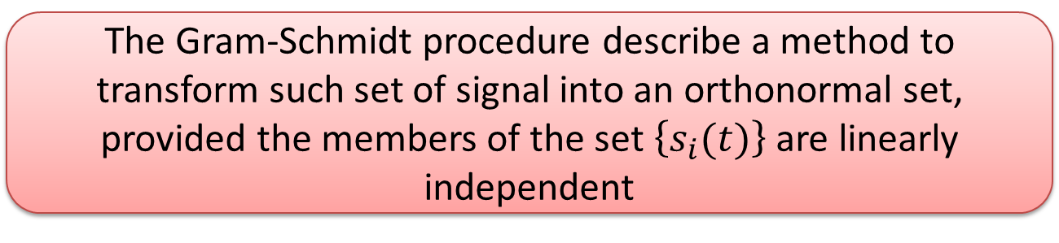

GRAM – SCHMIDT ORTHOGONALIZATION PROCEDURE (GSOP)
Why GSOP require ?
When we have an arbitrary set of M signals $\left\{s_{i}(t)\right\}$, then in general these signals will not be orthonormal.
The Gram-Schmidt procedure describe a method to transform such set of signal into an orthonormal set, provided the members of the set $\left\{s_{i}(t)\right\}$ are linearly independent
Linearly Independent means --- none of the signal $\left\{s_{i}(t)\right\}$can be written as a linear combination of the other signals.

Slide 8
GRAM – SCHMIDT ORTHOGONALIZATION PROCEDURE
Complete in two Stages
Stage-1 :
To identify whether the set is linearly independent or not
If the set is not linearly dependent then determine the subset which is linearly independent.
Stage-2 :
Construct a set of N orthonormal basis function
Determine the coefficient of expansion.

Slide 9
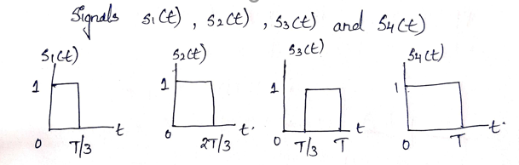
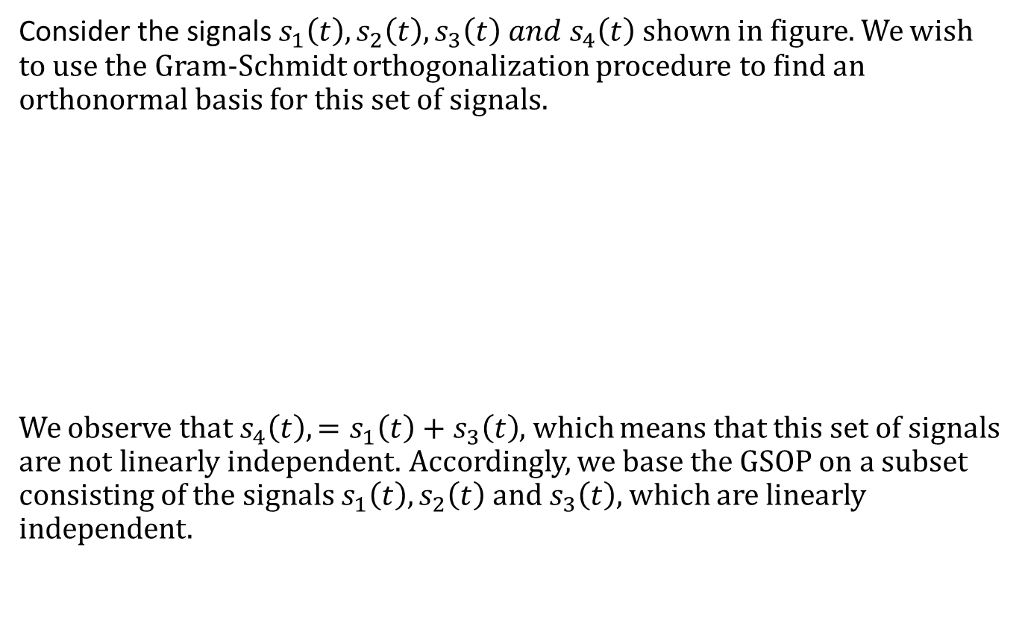
GRAM – SCHMIDT ORTHOGONALIZATION PROCEDURE Example
Consider the signals $s_{1}\left(t\right), s_{2}\left(t\right), s_{3}\left(t\right) and s_{4}\left(t\right)$ shown in figure. We wish to use the Gram-Schmidt orthogonalization procedure to find an orthonormal basis for this set of signals.
We observe that ${s_{4}\left(t\right),=s}_{1}\left(t\right)+s_{3}\left(t\right)$, which means that this set of signals are not linearly independent. Accordingly, we base the GSOP on a subset consisting of the signals $s_{1}\left(t\right), s_{2}\left(t\right) and s_{3}\left(t\right)$, which are linearly independent.

Slide 10
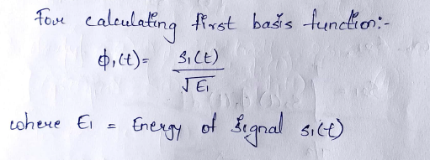
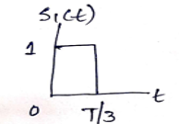
Example
We know,

Slide 12
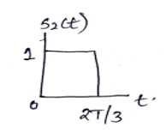
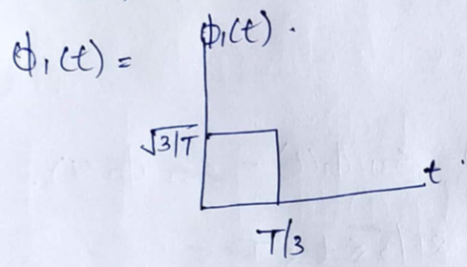
We have,

Slide 17
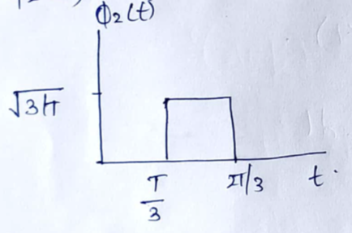
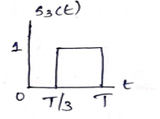
We have,

